Slide 1


CMR TECHNICAL CAMPUS UGC AUTONOMOUS Accredited by NBA & NAAC with ‘A’ Grade Approved by AICTE, New Delhi and JNTU, Hyderabad Kandlakoya(V), Medchal Road, Hyderabad-501401, Telangana Department of Computer Science and Engineering A FOREST FIRE IDENTIFICATION METHOD FOR UNMANNED AERIAL VEHICLE MONITORING VIDEO IMAGES
BATCH NO : 07
P. Rahul Yadav 217R1A0542
S. Sai Charan 217R1A0549
T. Saketh 217R1A0561
Under the Guidance of
Dr. N.BHASKAR
(Associate Professor)

Slide 2
Abstract
Introduction
Literature Survey
Problem Statement
Existing System
Proposed Methodology
Requirement Specification
Novelty
Implementation and Architecture
Sample Code
Results and Discussion
Conclusion
Future Scope
References
Github Link
contents

Slide 3
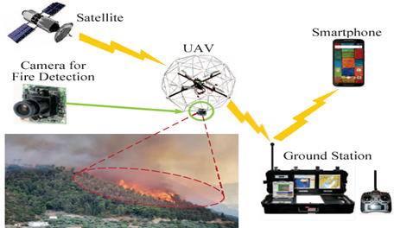
ABSTRACT
The study focuses on automatically detecting forest fires using drone (UAV) videos for faster and more efficient real-time monitoring. Motion detection is done using dense optical flow, while background modeling removes unnecessary background details. The system extracts important information, like energy and texture patterns, from the video to identify fire areas. These metrics help differentiate between fire and non-fire regions. The method was tested and performed better than traditional fire detection techniques, making it more reliable. The study advances forest fire monitoring by integrating drones and dynamic video analysis.

Slide 4
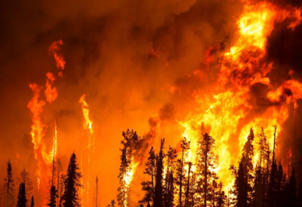
introduction
Detecting forest fires is important to protect natural resources and maintain environmental sustainability.
Traditional methods like satellite imaging and sensor networks have problems such as slow updates and high costs, limiting their effectiveness.
A drone (UAV)-based approach offers a better solution for real-time, efficient fire monitoring.
This research uses drone video analysis to detect forest fires by applying advanced image processing techniques.
The method addresses challenges like changing backgrounds and improves the accuracy of fire detection.

Slide 5
Literature survey
Authors | Title of Research | Methodology | Advantages | Disadvantages
G. Lewis S., Clarke M. | Forest plots: Trying to see the wood and the trees | Meta-analysis; Forest plots to show variation between studies. | Easy visualization of data from multiple studies; Shows the variation and overall result. | Difficult to draw in most standard computer packages.
Turner D., Lewis M., Ostendorf B. | Spatial indicators of fire risk in the arid and semi-arid zone of Australia | Integration of ecological and environmental indicators with management practices. | Combines scientific development with management practices for better monitoring and fire risk management. | Not specified.
Adab H. | Using Probabilistic Methods to Evaluate Landfire Hazard | Probability distribution analysis to evaluate landfire hazards based on physiographic and anthropogenic factors. | Effectively analyzes fire risk on flat areas, slopes, and lowland zones; Identifies human activities as key fire determinants. | Limited application in highland and steep slope areas; few studies focus on probabilistic methods.
Lei Z., Lu J. | Distributed coverage of forest fire border based on WSN | Wireless Sensor Network (WSN) for real-time detection and monitoring of forest fires. | Real-time alerts; Measures gases (CO2, CO, CH4), temperature, humidity, and GPS data; Efficiently detects and monitors forest fires. | Dependency on the wireless network's performance and coverage; Possible limitations in forest density.
Jadhav P., Deshmukh V. | Forest fire monitoring system based on Zig-Bee wireless sensor network | ZigBee-based wireless sensor network for real-time forest fire monitoring. | Low-energy consumption; Real-time monitoring; Cluster tree network topology improves data transmission efficiency. | Limited to small processing capacity of microprocessors in sensor nodes; Dependent on wireless communication, which can be unstable in certain terrains.
Liu L. Y., Fan X. J. | The Design of System to Texture Feature Analysis Based on Gray Level Co-Occurrence Matrix | Gray Level Co-Occurrence Matrix (GLCM) and Adaptive Histogram Equalization (AHE) to convert and enhance grayscale images. | Provides efficient feature extraction for image analysis; Improves the identification performance of grayscale images through enhancement techniques like AHE. | Limited application to grayscale images; May not fully capture the complexities of forest fire images; Dependence on software like Matlab for conversion.

Slide 6
Problem statement
The method focuses on identifying forest fires using video footage captured by drones (UAVs).
It analyzes the video to detect fire in real-time while the UAV monitors the forest.
The goal is to improve fire detection accuracy and speed using video from UAVs.
This approach helps in better and faster identification of forest fires compared to traditional methods.
Domains:
Unmanned Aerial Vehicle(UAV) Monitoring
Image Processing
Machine Learning and Pattern Recognition
Environmental Monitoring

Slide 7
EXISTING SYSTEMS
Traditional forest fire monitoring methods are slow and not efficient in providing real-time data.
An eight-rotor drone (UAV) is commonly used for fire detection because it can carry heavy loads, fly for long periods, and handle strong winds.
Each rotor has an independent motor, with nearby motors rotating in opposite directions to stay balanced and stable.
The drone's speed and movement are controlled by the eight rotors, allowing it to move freely and monitor forest fires accurately and in real-time.
Disadvantages of existing systems:
Less Accuracy
Less Efficiency

Slide 8
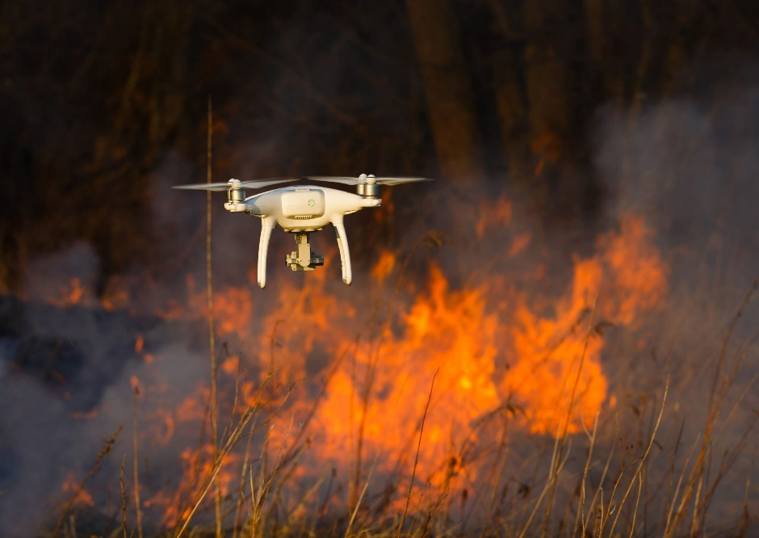
Proposed methodology
The system uses advanced video analysis to improve forest fire detection with drones (UAVs).
It tackles problems faced by traditional methods, like dealing with fog or changing backgrounds, through motion detection and background removal.
Machine learning is used to identify fire by analyzing specific features like wavelet energy and textures.
This approach increases the accuracy, adaptability, and reliability of detecting forest fires, helping to protect forest resources more effectively.

Slide 9
Advantages of proposed system
High Accuracy
High Efficiency
Modules:
Image Processing (BGR to RGB)
Motion Detection
Color Features Extraction (Fire Detection)
Wavelet and Texture Extraction

Slide 10

Requirements specification
Hardware requirements :
System : Any modern personal Computer(PC) or Laptop
Processor : Intel core i5
Hard disk : minimum 40GB
RAM : At least 8GB
Software requirements :
Operating System : Windows 11
Coding Language : Python (v3.7)
Framework : OpenCV, Numpy,Tkinter
Designing : Tkinter

Slide 11
NOVELTY
The novelty of this project lies in the use of adaptive image analysis techniques that adjust based on real-time video data and environmental factors. This adaptability ensures consistent performance in diverse terrains and weather conditions, making our forest fire detection system more robust and effective than traditional fixed-camera methods.

Slide 12
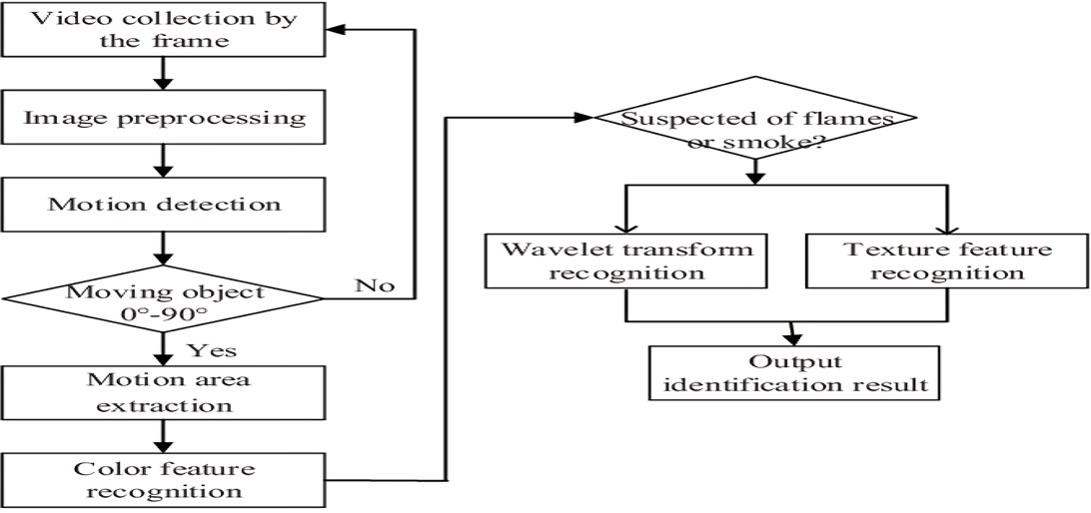
IMPLEMENTATION

Slide 13
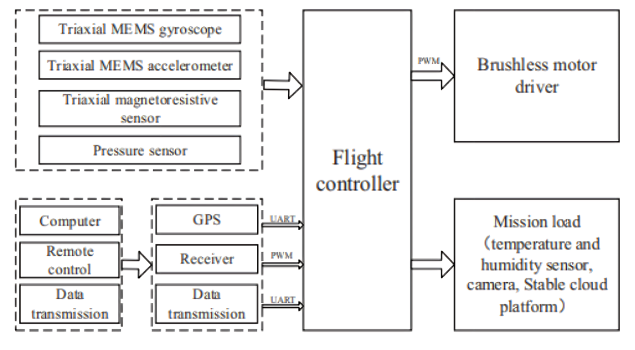
Architecture

Slide 14
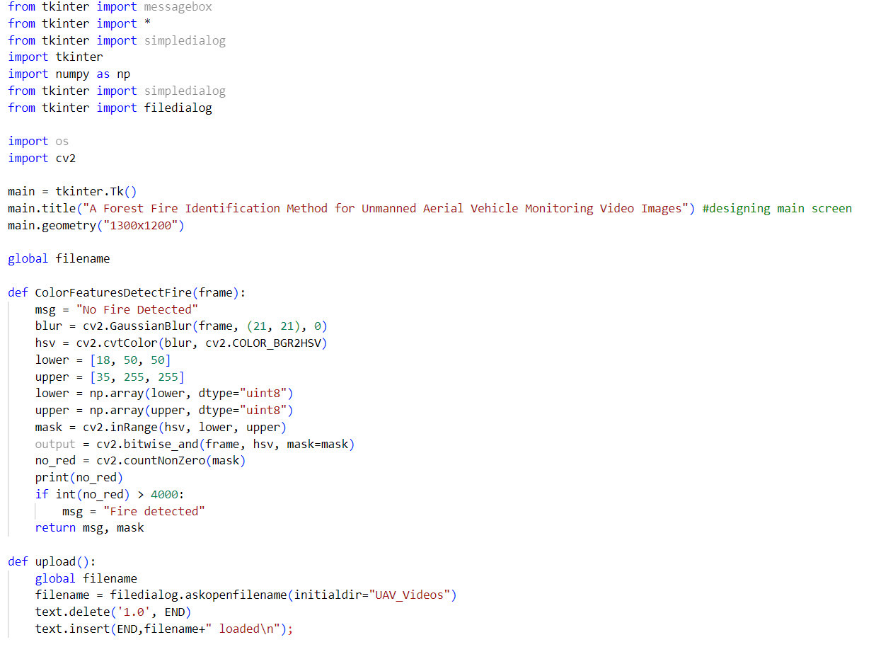
SAMPLE CODE

Slide 15
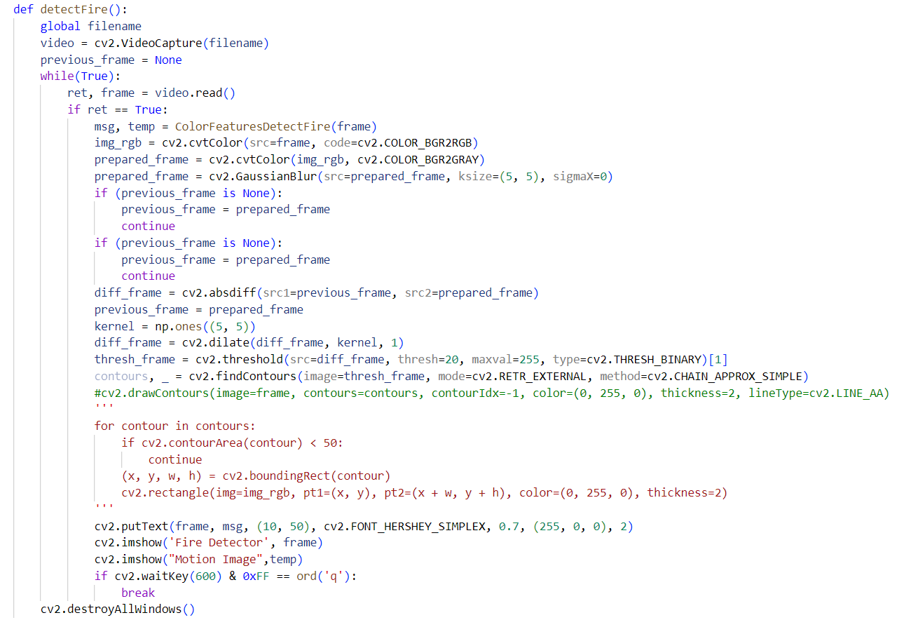
SAMPLE CODE

Slide 16
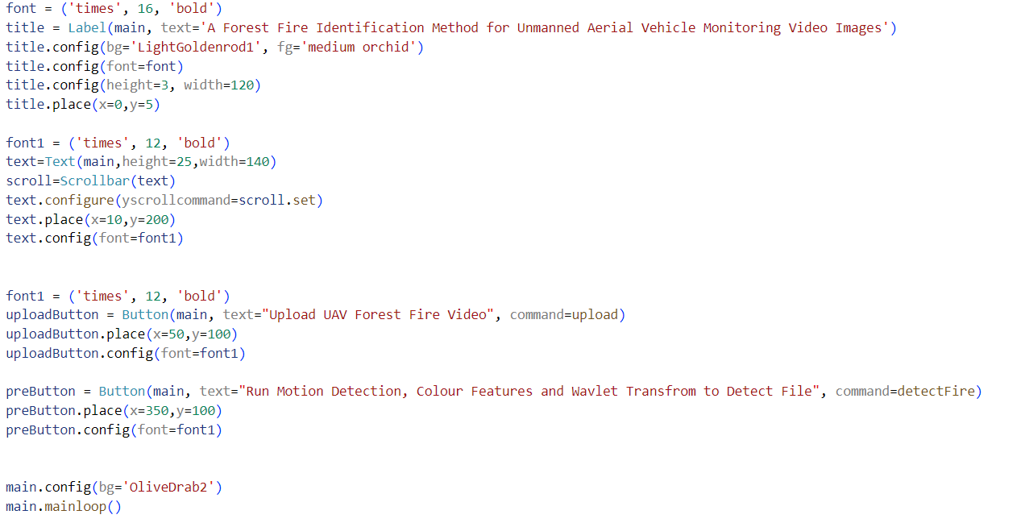
SAMPLE CODE

Slide 17


Results and discussion
The project successfully identifies forest fires in real-time using video footage from drones and advanced image analysis. The system uses motion detection, color feature extraction, and wavelet texture analysis to separate fire from other background elements.

Slide 18
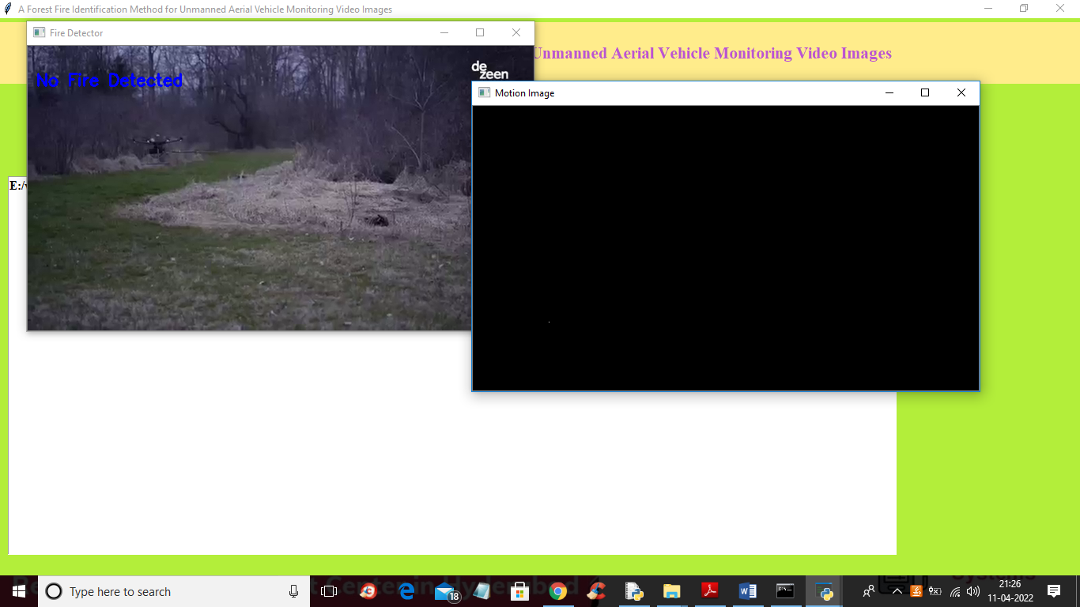
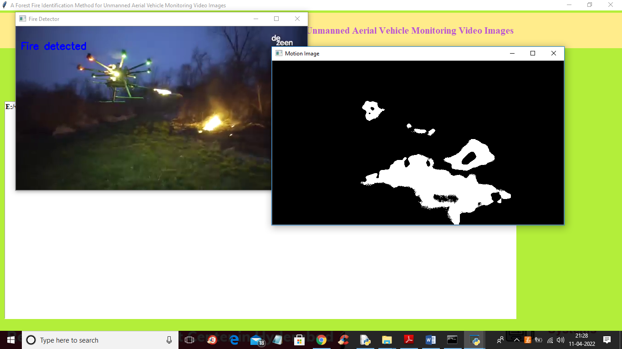
RESULTS AND DISCUSSION

Slide 19
CONCLUSION
In this project, we use a multi-rotor unmanned aerial vehicle (UAV) equipped with a video camera to monitor forest fires. The UAV captures video footage, and we extract individual frames for analysis. A new method is proposed for detecting forest fires in these video frames, based on analyzing certain static characteristics of fire, such as angular second moment, entropy, and reciprocal differential moment. These features help in distinguishing forest fires from other objects in the scene. The system performs real-time monitoring and automatically identifies forest fires using this method. Our experimental results demonstrate that the proposed algorithm is effective in accurately detecting and monitoring forest fires in real time, providing an efficient solution for early fire detection with UAV technology. This approach can help in rapid response to forest fire incidents, improving safety and minimizing damage.

Slide 20
Future scope
The future of this forest fire detection method involves combining data from various sources like satellite images, weather data, and IoT sensors for more accurate fire detection. Future advancements will refine machine learning and use deep learning techniques like CNNs for image data and RNNs for time-based data to boost detection accuracy. Improving how fire patterns are captured over time and space will help detect fires more precisely, using methods like spatial interpolation and time series analysis. Adding methods to handle uncertainty, such as Bayesian approaches and ensemble models, will make predictions more reliable. Integrating real-time monitoring with decision-making tools will provide quicker and more effective responses to forest fires for stakeholders.

Slide 21
references
G. Lewis S, Clarke M. Forest plots: trying to see the wood and the trees.[J]. Bmj, 2001.
Turner D, Lewis M, Ostendorf B. Spatial indicators of fire risk in the arid and semi-arid zone of Australia[J]. Ecological Indicators, 2011.
Adab H. Using Probabilistic Methods to Evaluate Landfire Hazard[C]// International Conference on Environmental Engineering. 2016.
Lei Z, Lu J. Distributed coverage of forest fire border based on WSN[C]// International Conference on Industrial and Information Systems. IEEE, 2010.
Jadhav P., Deshmukh V., et al. Forest fire monitoring system based on Zig-Bee wireless sensor network[J]. Internation Journal of Emerging Technology and Advanced Engineering, 2012.
Liu L Y, Fan X J. The Design of System to Texture Feature Analysis Based on Gray Level Co-Occurrence Matrix[J]. Applied Mechanics & Materials, 2015.

Slide 22
GITHUB LINK
https://github.com/Rahul1418/Forest-Fire-Identification

Slide 23
Thank you

